Slide 1



SQL Project on Multi-Brand Car Dataset
By-
Phanindra Bhushan Chaturvedi & Ankit Yadav

Slide 2




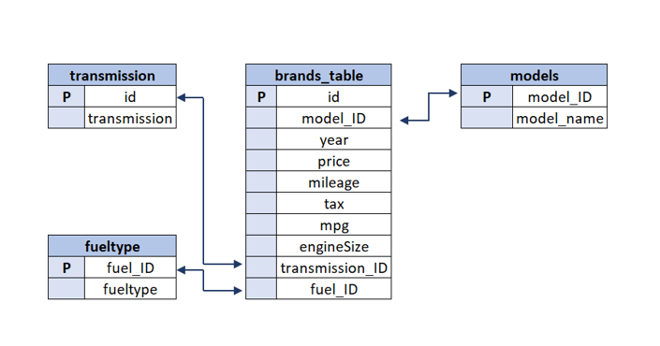
Schema Of Dataset - (An Overview)

Slide 3
ABOUT THE PROJECT
You are working as an analyst for a Car brand. The brand wants to launch one(or multiple types) car. You are given the post-purchase data for various Car brands and their models and have been asked to create a detailed analysis using the given data:
Note: Use your creativity to get interesting insights from the data. Use Excel only for reporting and presentation. Rest all the points to analysis using SQL only.
Create an analysis to find the income class of UK citizens based on the price of Cars(You can use per-capita income in the UK from internet sources)
Categorize the cars on the basis of their price(Create as many buckets as you want as per your understanding of data) and analyze the:
(a.)price changes across the years and identifies the categories which have seen a significant jump in their price
(b.) changes in the number of cars sold across the years and identify the categories which have seen a significant jump in their sales

Slide 4
About project-(part-2)
Using the above-identified categories for both points (a) & (b), do a root cause analysis to identify the probable reason for their increase.
For, e.g., Its fuel efficiency as compared to other types of cars could be a reason.
3.Find relationship between fuel efficiency & price of car/sales of car/fuel type/, etc.
4.Create an analysis to show the effect of fuel expenditure on the sales of car over the years(Get the fuel prices in the UK through the years through internet sources)
Using all of the above analysis, suggest cost and usage effective car types for the brand to launch(We can launch multiple types of car as well)
You are also asked to rank across all the models based on their total sales, average price, average mileage, average engine size, etc. and now filter the top 5 basis their sales. Observe the identified models and provide your inference.
Make a Dynamic Excel Dashboard from your findings, plot graphs & create multiple tabs as needed, be as creative as you can.

Slide 5
About Dataset -
We are having total 8 Dataset-
1.For car Brand-(5 dataset)
a.)Audi
b.)BMW
c.)Mercedes
d.)Hyundai
e.)C CLASS
2.Car related Dataset-(3 Dataset)
a.)Model
b.)Transmission Type
c.)Fuel Type
Our approach with the Dataset-
1.Created a VIEW in SQL to create union of all 5 Brand dataset
2.Two column in c class were missing (tax & mpg column) so we created two empty Column with same name so as to do Union of dataset
3.Used join operation for joining Rest of the Tables with our View as per requirement

Slide 6
1.Create an analysis to find the income class of UK citizens based on the price of Cars
On Basis of Purchasing Power
Price Range | Income Group
Below 10000 | Lower Income
10000-20000 | Lower Middle Income
20000-30000 | Upper Middle Income
Above 30000 | High Income
Income_Group | Total count
Lower Middle Income | 17976
Upper Middle Income | 13832
Lower Income | 3811
High Income | 7708

Slide 7
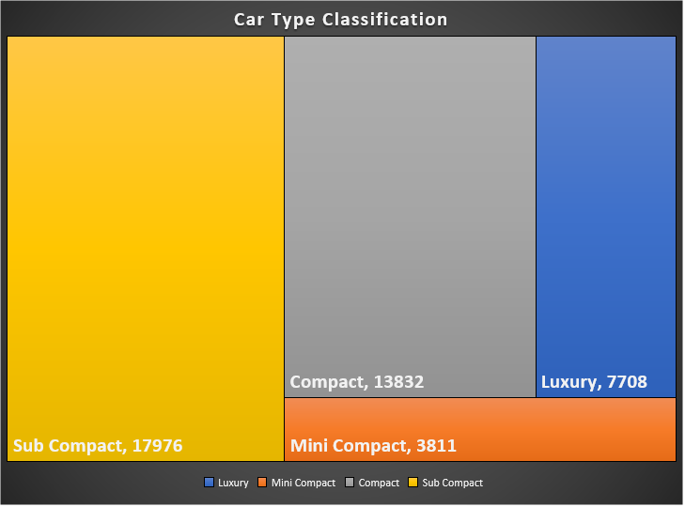
2. Categorize the cars on the basis of their price
Price Range | Type of Car
Below 10000 | Mini Compact
10000-20000 | Sub Compact
20000-30000 | Compact
Above 30000 | Luxury
Key Findings-
The sale of sub compact car( i.e. the car in the range of 10000 to 20000) is maximum

Slide 8
2.a) Price changes across the years and identifies the categories which have seen a significant jump in their price
Key Findings-
1.We can see there is huge change in the price of car from 2012 to 2020
2.It is highest for the price Range of 20000 to 300000 ,it could be due to change in Economic and other policy change by the government

Slide 9
2.b.Changes in the number of cars sold across the years
Key Findings and Analysis-
1.Russia and China were the major Car importer of UK , after second quarter of 2015 economy of these countries suffered thus demand for car also decreased
2.Due to wanning Global Economy the Production and Construction sector of UK suffered
3.Some Political and Economic changes lead to the downfall of car manufacturing sector after 2015

Slide 10
3.Find relationship between fuel efficiency & price of car/sales of car/fuel type/, etc.
Efficiency Of Electric Car is Maximum
Car With Manual Transmission have Highest Efficiency
Smaller the Engine lesser will be fuel consumption and larger will be the Efficiency

Slide 11
Key Findings-
We know that the Cost of Car increase with size and number of engine
As engine size increase Fuel consumption also increase and hence efficiency on the basis of fuel consumption decreases
So we can say as the Price decreases efficiency increases

Slide 12
Total Sales Vs Miles per Gallon
Sale is Maximum for efficiency around 50 mpg
On an Average We can say Sale Maximum in Range of 56 to 66 mpg

Slide 13
4.Create an analysis to show the effect of fuel expenditure on the sales of car over the years
We can Say that as price per Gallon Decreased there was increase in sales(ignoring outliers)

Slide 14
5.Rank across all the models based on their total sales, average price, average mileage, average engine size, etc.
Total Sales is Maximum For CCLASS Brand with Model C CLASS
Our output is almost same while filtering for the Price Range of 10000 to 30000
Since Majority of customers are from this range

Slide 15
These are the few Observations on the basis of Avg Mileage, Avg Engine Size, Avg Price

Slide 16
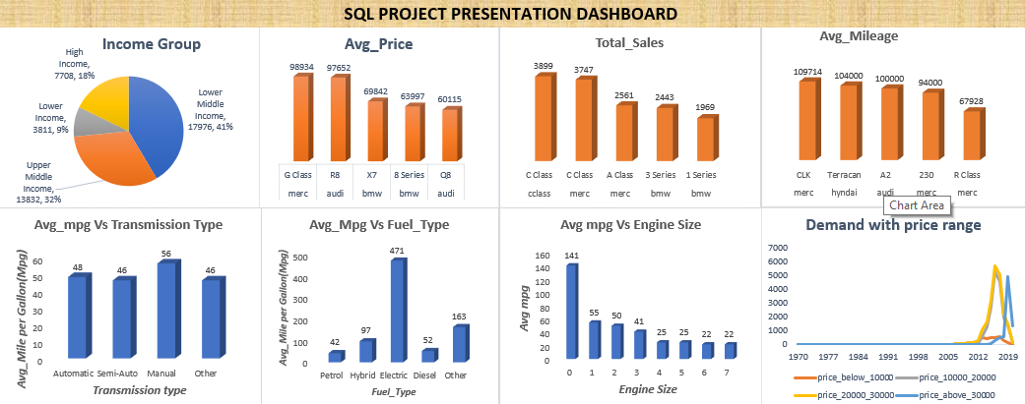

Slide 17
Conclusion
Efficiency of Transmission type Manual is more
Efficiency of Electric Vehicle is more
Demand of Small Engine size Car is more as fuel consumption by them is less hence more economical and efficient
Demand is rising for car in Price Range of 20000 to 30000(UK POUND)
If we have to launch a car model, then by analyzing the above data it has been found that there is more demand of C class then A class and 3 series type car models, then this type of car model can be launched and Its consumption is also very high.

Slide 18
Challenges Faced :-
Two columns(Tax column and mpg column) were missing from C Class dataset ,so we added two blank column with same column name.
We tried to make our visualization part on Tableau public by linking SQL server with it but then we came to know we can’t link Tableau public with SQL server ,so we did our visualization in Excel.
We were unable to fetch previous year fuel price of Diesel fuel so we took Petrol price as average fuel price and did our visualization

Slide 19
Thank You

